Slide 1

Session - 6

Slide 2
Content
Introduction to Pages
Content Page
Master Detail Page
Navigation Page
Tabbed Page
Templated Page
Carousel Page

Slide 3
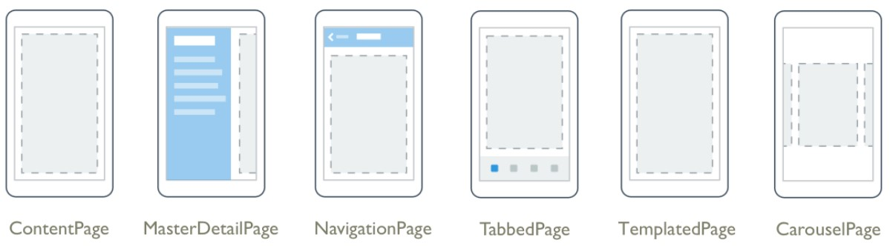

Slide 4
Introduction to Pages
All the page types are derive from the Xamarin.Forms Page class.
Pages are visual elements occupy all or most of the screen.
A Page object represents a ViewController in iOS and a Page in the Universal Windows Platform.
On Android, each page takes up the screen like an Activity, but Xamarin.Forms pages are not Activity objects.

Slide 5
Content Page
ContentPage is the simplest and most common type of page.
Set the Content property to a single View object, which is most often a Layout such as StackLayout, Grid, or ScrollView.
Property:
Content - Gets or sets the view that contains the content of the Page

Slide 6
Master Detail Page
A MasterDetailPage manages two pages of information.
Set the Master property to a page generally showing a list or menu.
Set the Detail property to a page showing a selected item from the master page.
The IsPresented property governs whether the master or detail page is visible.
Properties:
Detail - Gets or sets the detail page that is used to display details about items on the master page.
IsGestureEnabled - Gets or sets a value that turns on or off the gesture to reveal the master page.
IsPresented - Gets or sets a value that indicates whether or not the visual element that is represented by the MasterDetailPage.Masterproperty is presented to the user.
Master - Gets or sets the master page.
MasterBehavior - Gets or sets a value that indicates how detail content is displayed.

Slide 7
Events
BackButtonPressed - For internal use by the Xamarin.Forms platform.
IsPresentedChanged - Event that is raised when the visual element that is represented by the MasterDetailPage.Master property is presented or hidden.
Key Points:
A MasterDetailPage is designed to be a root page.
It's recommended that the master page of a MasterDetailPage should always be a ContentPage.
And detail page should only be populated with TabbedPage, NavigationPage, and ContentPage.

Slide 8
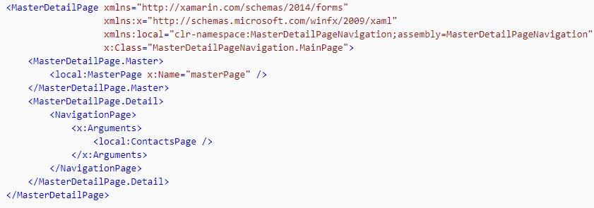
Xaml Implementation

Slide 9
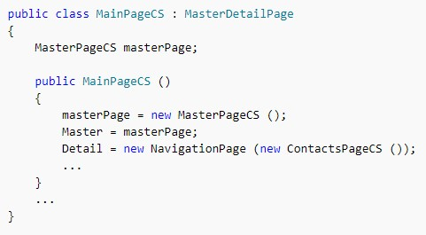
C# Implementation

Slide 10
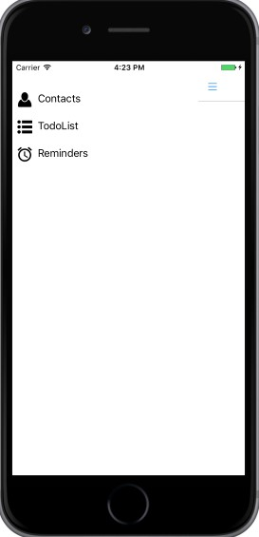
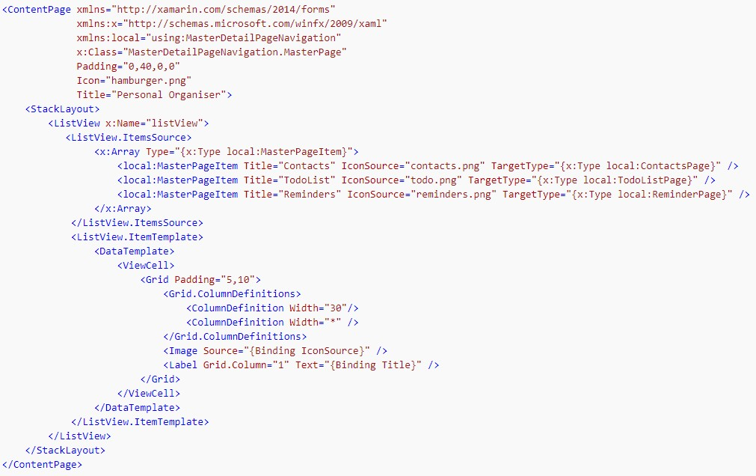
Creating Master Page

Slide 11
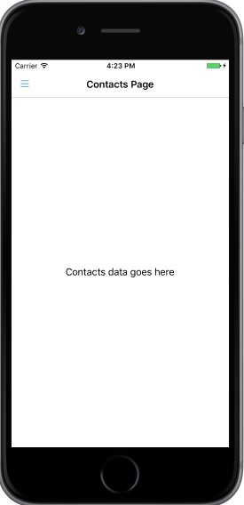
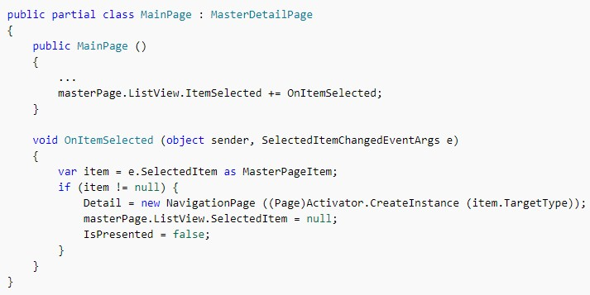
Navigation to Detail Page

Slide 12
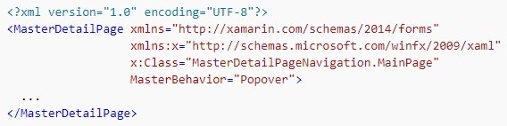
Controlling the Detail Page Display Behavior
MasterBehavior property - This property determines how the detail page will be displayed. They are:
Default – The pages are displayed using the platform default.
Popover – The detail page covers, or partially covers the master page.
Split – The master page is displayed on the left and the detail page is on the right.
SplitOnLandscape – A split screen is used when the device is in landscape orientation.
SplitOnPortrait – A split screen is used when the device is in portrait orientation.

Slide 13
Navigation Page
The NavigationPage manages navigation among other pages using a stack-based architecture.
When using page navigation in your application, an instance of the home page should be passed to the constructor of a NavigationPage object.
Properties:
BarBackgroundColor - Gets or sets the background color for the bar at the top of the NavigationPage.
BarTextColor - Gets or sets the text that appears on the bar at the top of the NavigationPage.
CurrentPage - The Page that is currently top-most on the navigation stack.
Pages - For internal use by the Xamarin.Forms platform.
RootPage - The Page that is the root of the navigation stack.
StackDepth - For internal use by the Xamarin.Forms platform.
Tint - The color to be used as the Tint of the NavigationPage.

Slide 14
Events
Popped - Event that is raised after a page is popped from this NavigationPage element.
PoppedToRoot - Event that is raised when the last nonroot element is popped from this NavigationPage element.
Pushed - Event that is raised when a page is pushed onto this NavigationPage element.

Slide 15
Methods
PopAsync() : Asynchronously removes the top Page from the navigation stack.
PopToRootAsync() : Pops all but the root Page off the navigation stack.
PushAsync(Page) : Presents a Page modally.
SetBackButtonTitle() : Sets the title that appears on the back button for page.
SetHasBackButton() : Adds or removes a back button to page, with optional animation.
SetHasNavigationBar() : Sets a value that indicates whether or not this NavigationPage element has a navigation bar.
SetTitleIcon() : Sets the title icon of the bindable to the icon file at value.

Slide 16
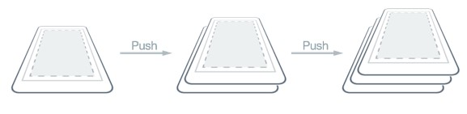
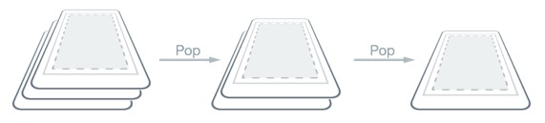

Slide 17
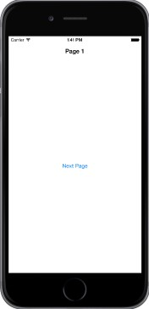

Creating Root Page

Slide 18
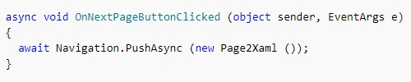


Pushing or Poping Pages with Navigation Stack

Slide 19

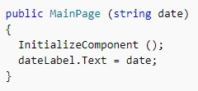
Passing data while navigating
App.xaml.cs
MainPage.xaml.cs

Slide 20
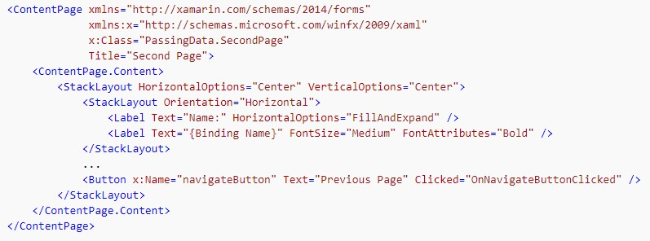
Passing data through BindingContext

Slide 21
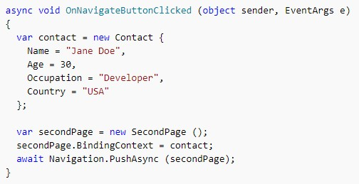

Slide 22
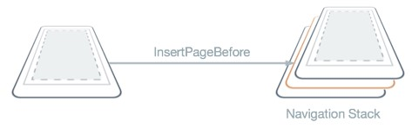
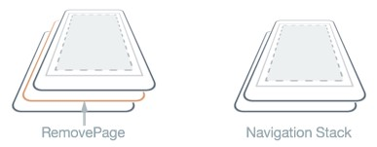
Manipulating the Navigation Stack
InsertPageBefore Method
RemovePage Method

Slide 23
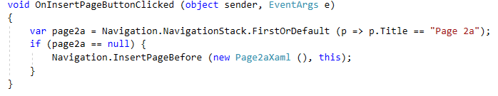
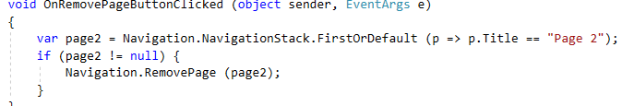
InsertPageBefore Method
RemovePage Method

Slide 24
Modal Pages
Modal page encourages users to complete a task that cannot be navigated away from until the task is completed or cancelled.
To display a modal page the application will push it onto the modal stack
To return to the previous page the application will pop the current page from the modal stack, and the new topmost page becomes the active page

Slide 25
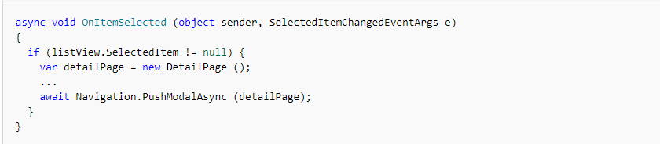
Pushing Pages from the Modal Stack
Modal navigation methods are exposed by the Navigation property on any Page derived types. These methods provide the ability to push modal pages onto the modal stack, and pop modal pages from the modal stack.
This causes the ModalPage instance to be pushed onto the modal stack, where it becomes the active page, provided that an item has been selected in the ListView on the MainPage instance

Slide 26
When PushModalAsync is invoked, the following events occur:
The page calling PushModalAsync has its OnDisappearing override invoked, provided that the underlying platform isn't Android.
The page being navigated to has its OnAppearing override invoked.
The PushAsync task completes.

Slide 27

Popping Pages from the Modal Stack
The active page can be popped from the modal stack by pressing the Back button on the device
To programmatically return to the original page, the ModalPage instance must invoke the PopModalAsync method,
This causes the ModalPage instance to be removed from the modal stack, with the new topmost page becoming the active page

Slide 28
PopModalAsync is invoked, the following events occur:
The page calling PopModalAsync has its OnDisappearing override invoked.
The page being returned to has its OnAppearing override invoked, provided that the underlying platform isn't Android.
The PopModalAsync task returns.

Slide 29
Tabbed Page
The TabbedPage page is a collection of tabs. Each tab has a title and may have an icon.
Properties:
BarBackgroundColor - Gets or sets the background color of the bar.
BarTextColor - Gets or sets the color of text on the bar.
Key Points:
It's recommended that a TabbedPage should be populated with NavigationPage and ContentPage instances only. This will help to ensure a consistent user experience across all platforms.

Slide 30
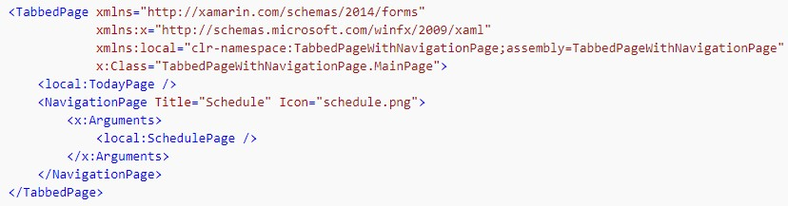

Slide 31
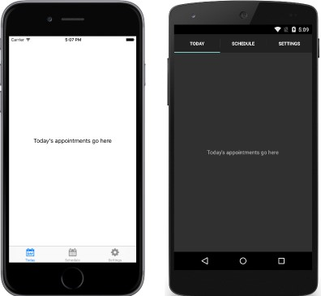
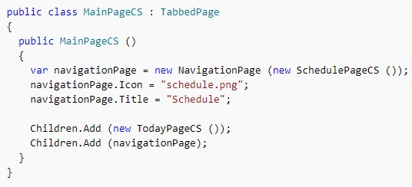

Slide 32
Templated Page
TemplatedPage displays full-screen content with a control template, and is the base class for ContentPage.
Property:
ControlTemplate - Gets or sets the control template that is used to display content.

Slide 33
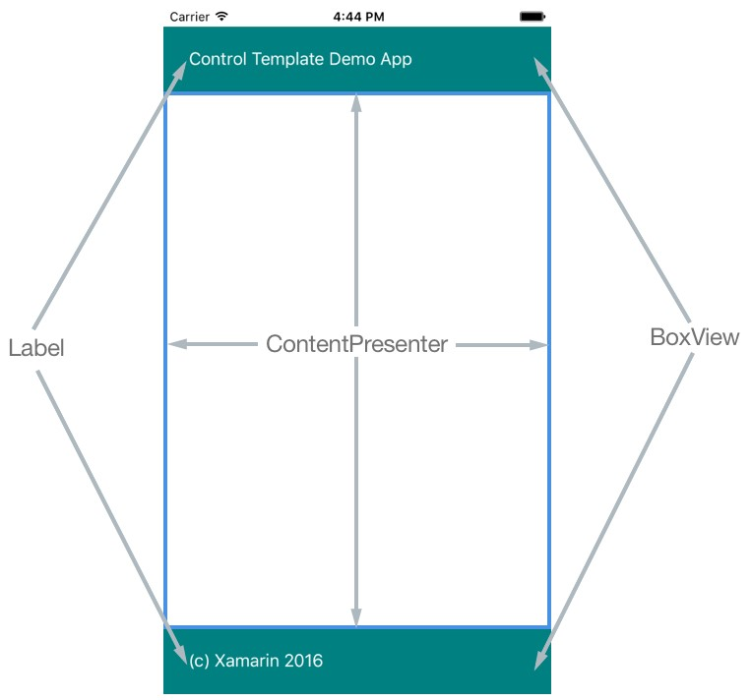

Slide 34
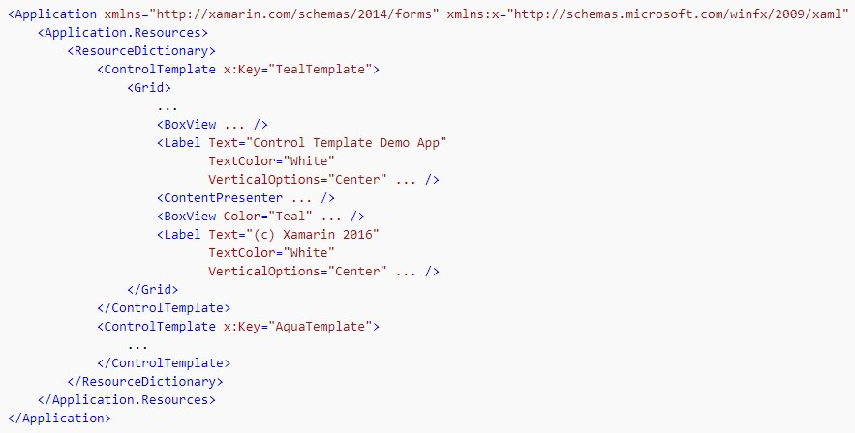
Creating Control Template

Slide 35
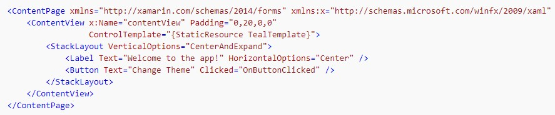
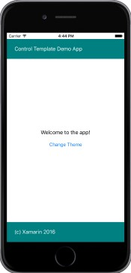

Slide 36
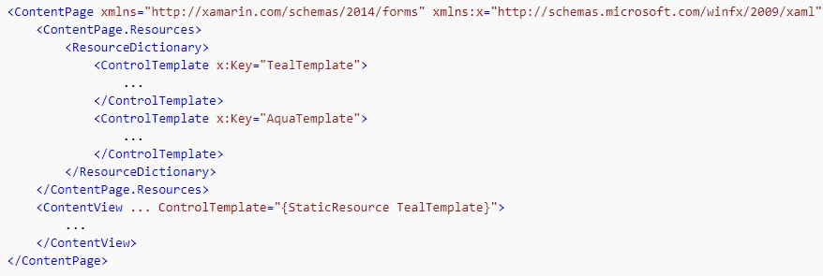
Creating Control Template at Page Level

Slide 37
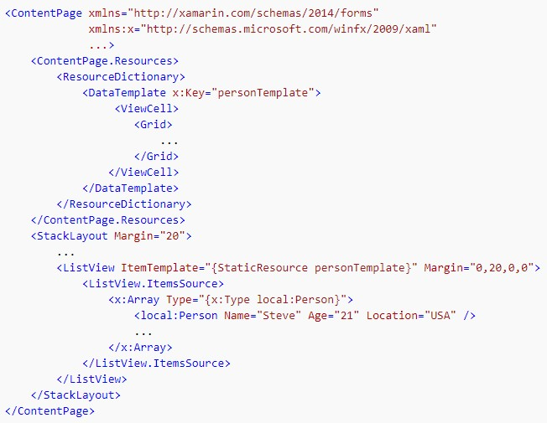
Creating Data Template as Resource

Slide 38
Carousel Page
CarouselPage is a page that users can swipe from side to side to navigate through pages of content
The layout of a CarouselPage is identical on each platform. Pages can be navigated through by swiping right to left to navigate forwards through the collection, and by swiping left to right to navigate backwards through the collection
Key Point:
A CarouselPage can only be populated with ContentPage instances, or ContentPage derivatives.

Slide 39
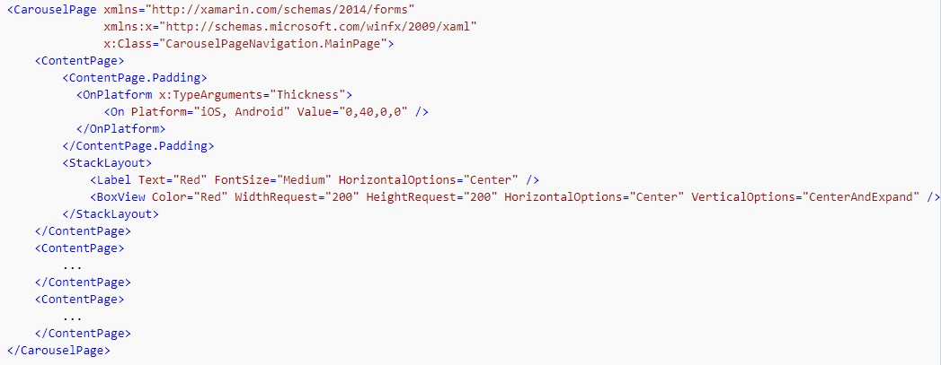

Slide 40
